Slide 1
Week 5
Computer Vision

Slide 2
What we have learnt in this week’s videos?
Semantic Segmentation
U-Net
Inception and Mobilenet
Faster RCNN

Slide 3




Session Agenda
Semantic Segmentation
U-Net
Depthwise Separable Convolutions
Mobilenet
Faster RCNN
Case study
Questions

Slide 4
Semantic Segmentation

Slide 5
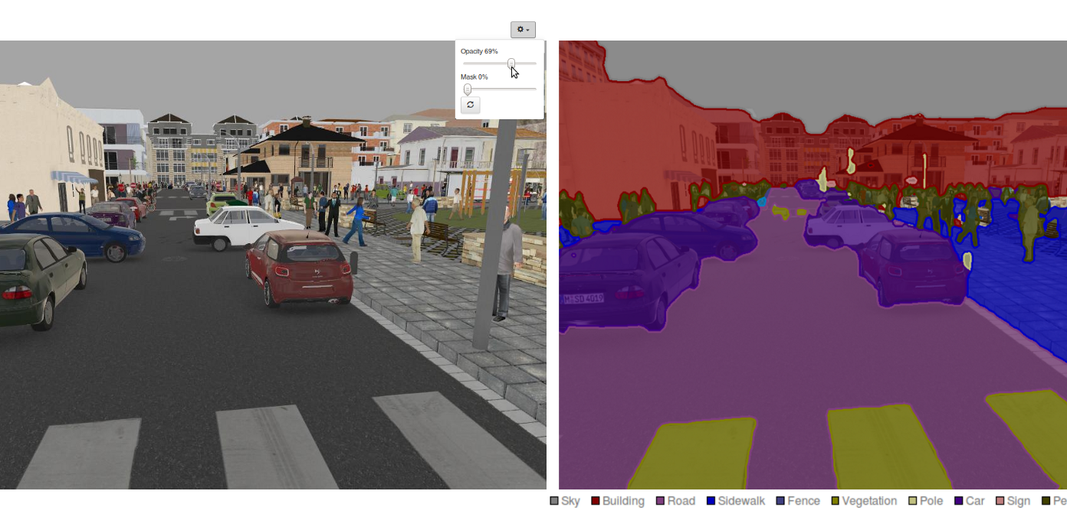
Example
An example of semantic segmentation

Slide 6
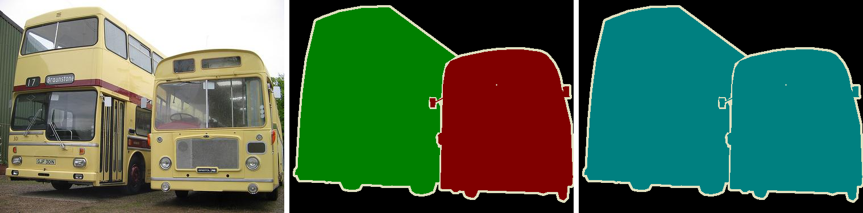
Instance Segmentation
Difference between Semantic Segmentation and Instance Segmentation. (middle) Although they are the same object (bus) they are classified as different objects. (Right) Same object, equal category.

Slide 7
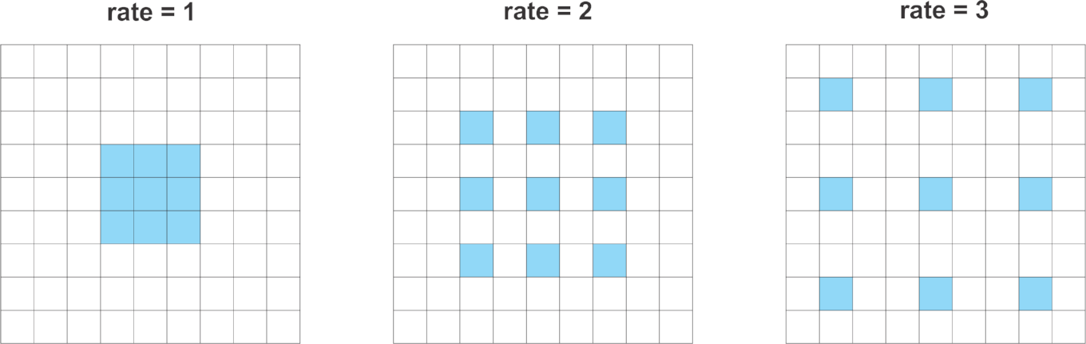
Atrous/Dilated Convolutions
Atrous (or dilated) convolutions are regular convolutions with a factor that allows us to expand the filter’s field of view.
Consider a 3x3 convolution filter for instance. When the dilation rate is equal to 1, it behaves like a standard convolution. But, if we set the dilation factor to 2, it has the effect of enlarging the convolution kernel.

Slide 8
U-Net

Slide 9
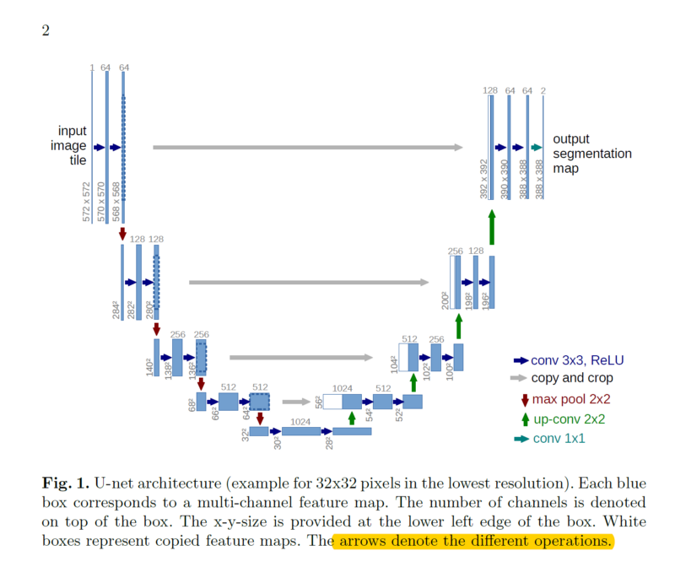
U-Net
The architecture contains two paths.
First path is the contraction path (also called as the encoder) which is used to capture the context in the image.
The encoder is just a traditional stack of convolutional and max pooling layers.
The second path is the symmetric expanding path (also called as the decoder) which is used to enable precise localization using transposed convolutions.
Thus it is an end-to-end fully convolutional network (FCN), i.e. it only contains Convolutional layers and does not contain any Dense layer because of which it can accept image of any size.

Slide 10
MobileNet

Slide 11
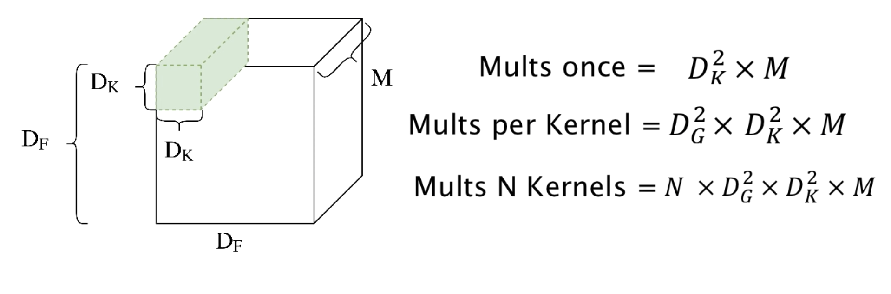











Standard Convolutions

Slide 12
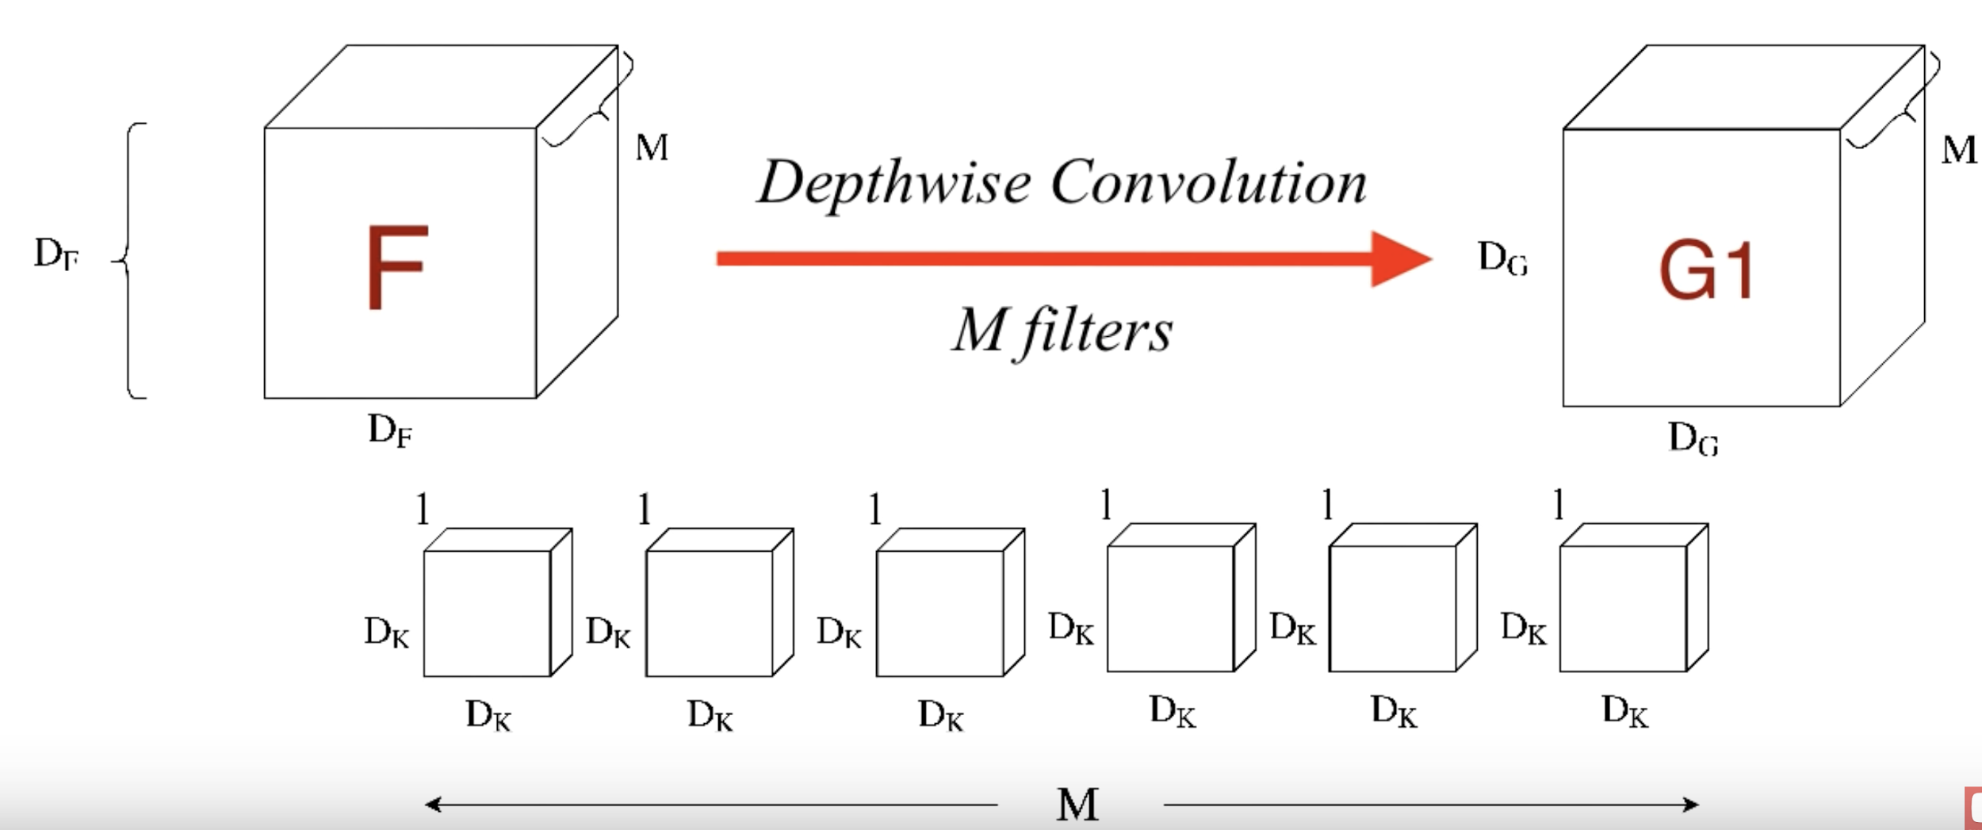




Depthwise

Slide 13
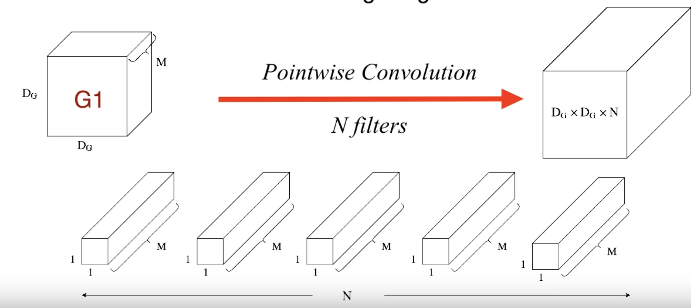


Pointwise

Slide 14
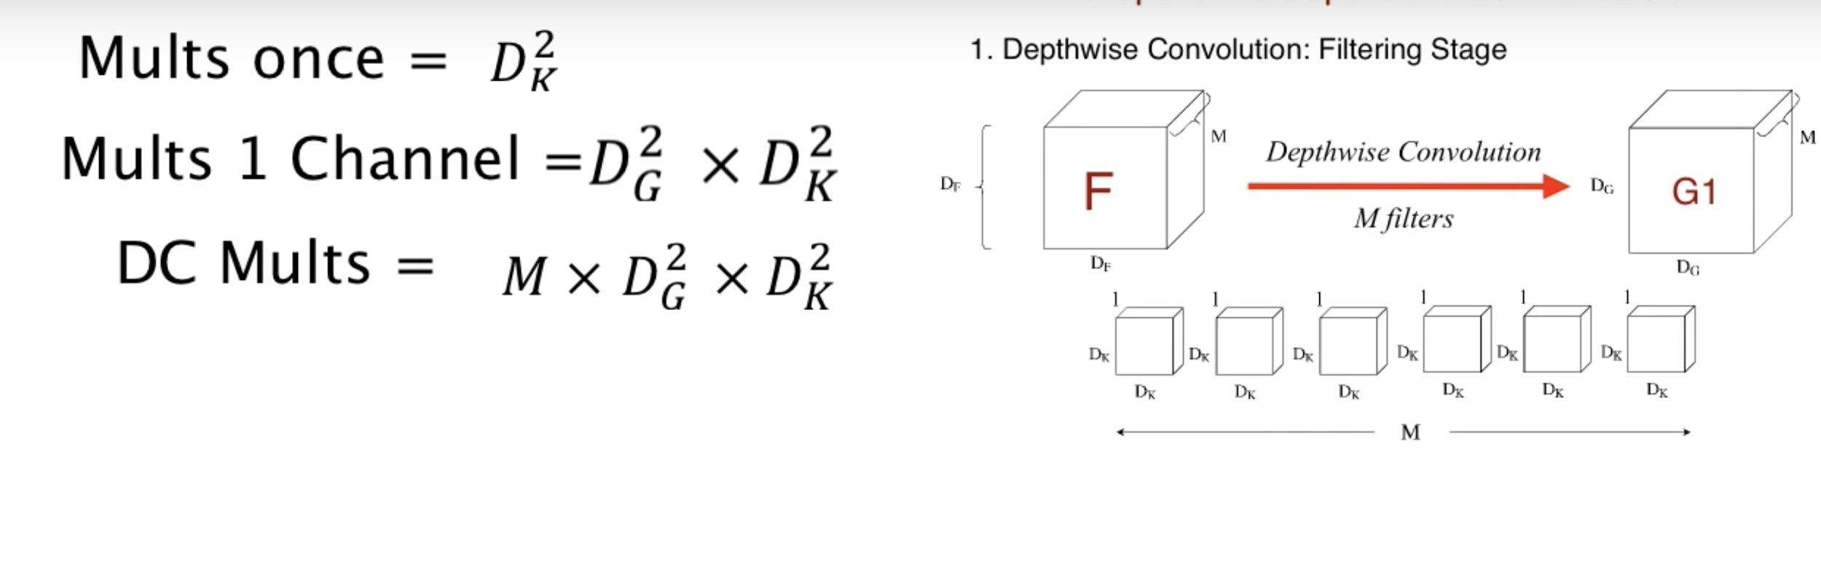









Step 1

Slide 15
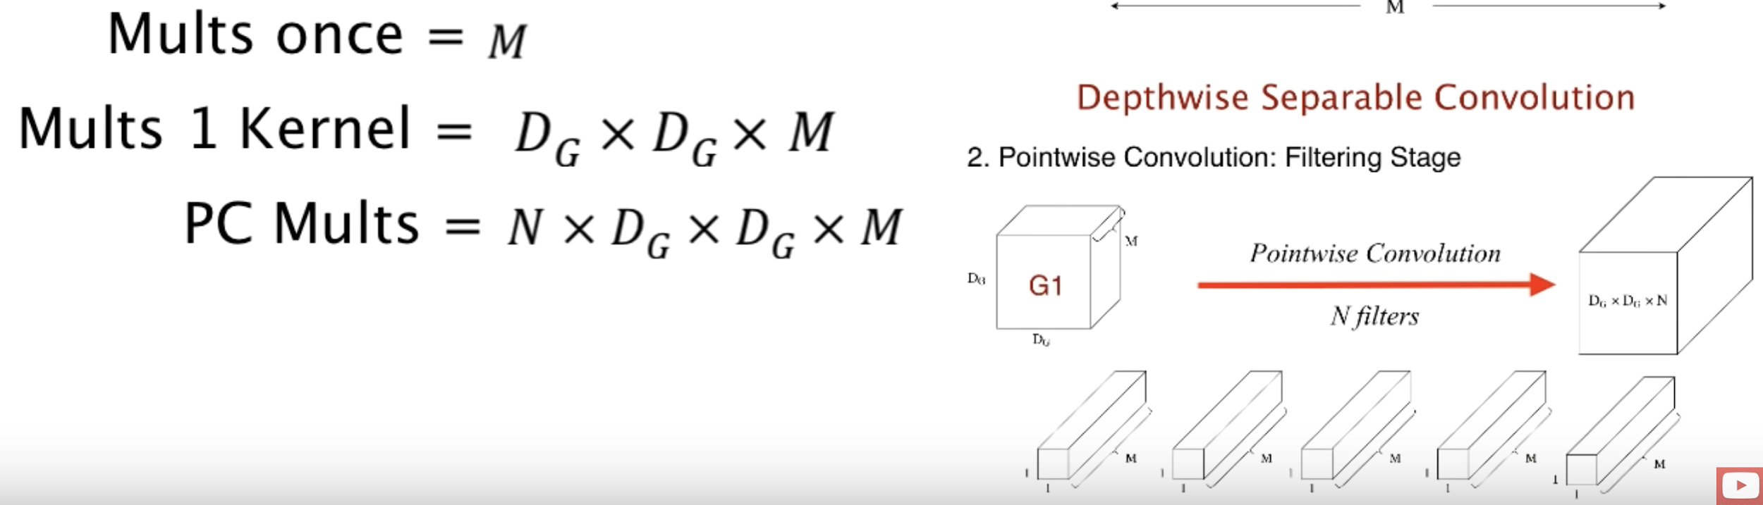







Step 2

Slide 16
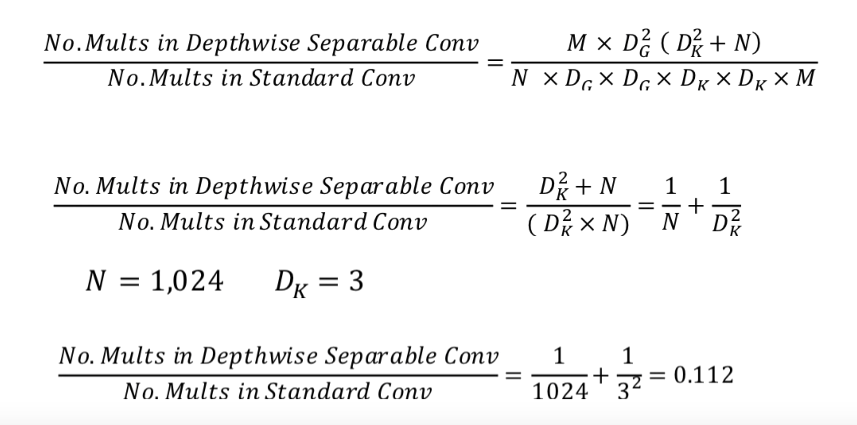



Comparison

Slide 17
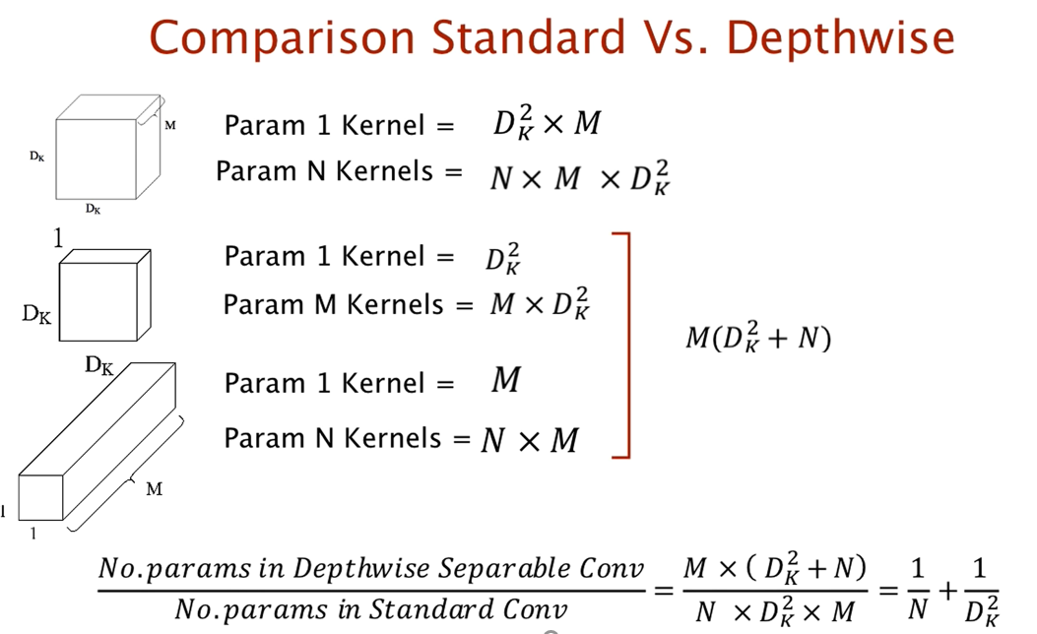

Slide 18
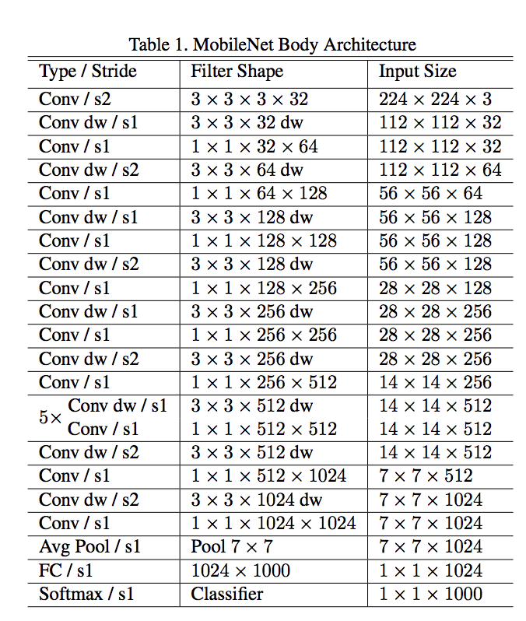

Mobilenet Architecture

Slide 19
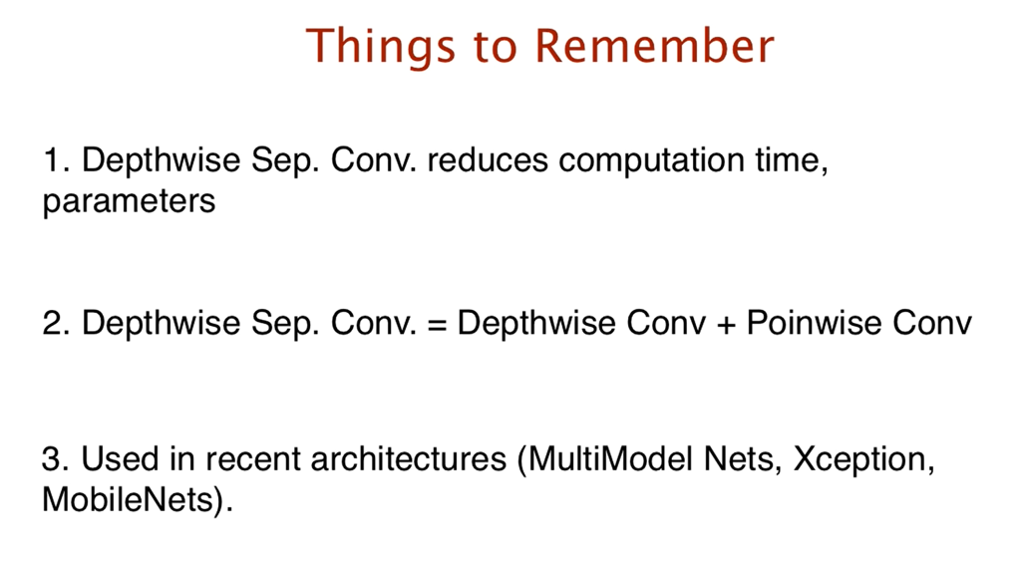

Slide 20
Faster RCNN

Slide 21
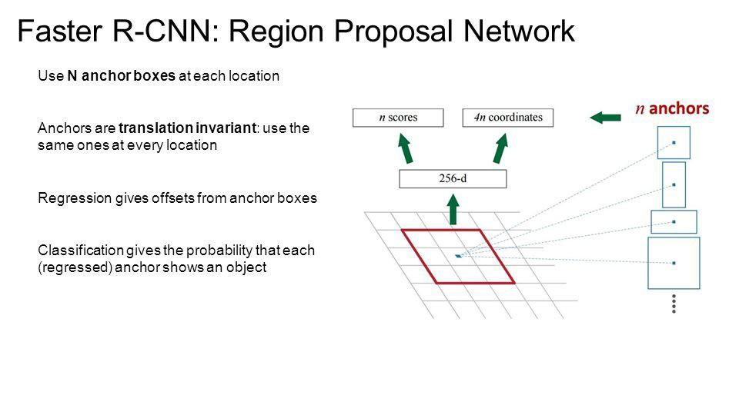
Region Proposal Network (RPN)
RPN is small neural network sliding on the last feature map of the convolution layers and predict wether there is an object or not and also predict the bounding box of those objects.

Slide 22
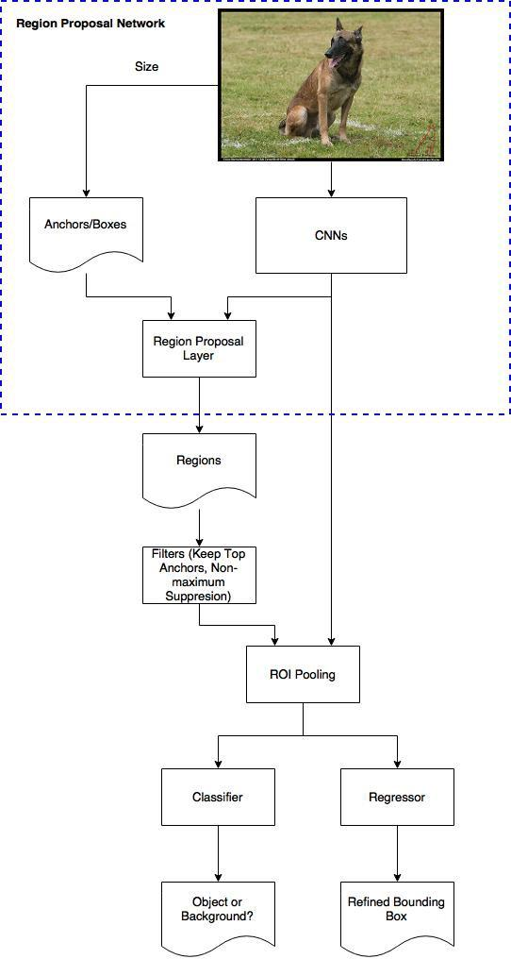
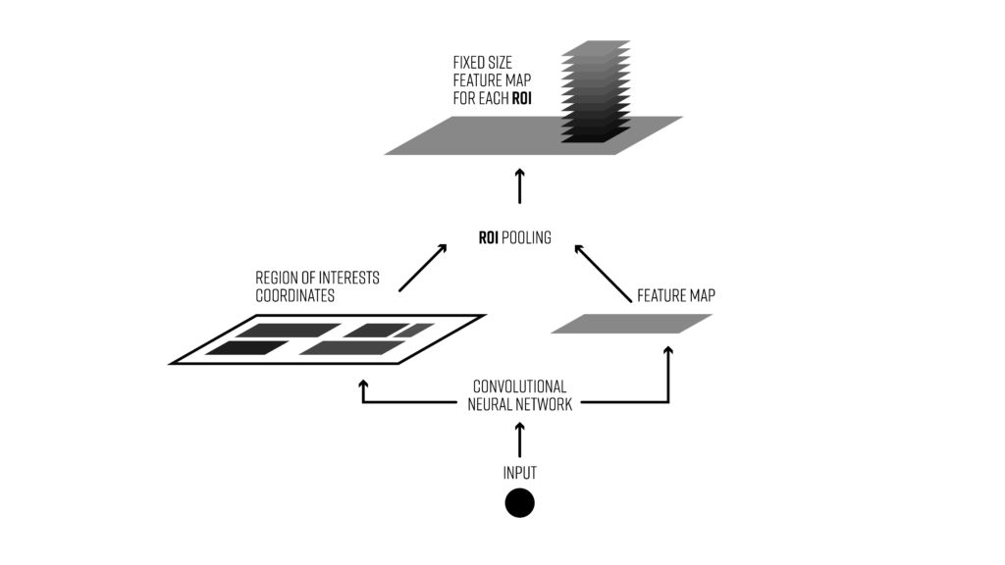
Faster RCNN
Using another Fully connected neural networks that takes as an input the regions proposed by the RPN and predict object class ( classification) and Bounding boxes (Regression).
ROI Pooling:
For every region of interest from the input list, it takes a section of the input feature map that corresponds to it and scales it to some predefined size (e.g., 7×7).
The scaling is done by:
T
Dividing the region proposal into equal-sized sections (the number of which is the same as the dimension of the output)
Finding the largest value in each section
Copying these max values to the output buffer.

Slide 23


AIML @WORK
PGPAIML @ Great Learning
Enabling Learners to Apply the AI/ML Concepts at Work
Apply AIML at your workplace to gain some instant benefits:
Get noticed by your management with your outstanding analysis backed by data science.
Create an impact in your organization by taking up small projects/initiatives to solve critical issues using data science.
Network with members from the data science vertical of your organization and seek opportunities to contribute in small projects.
Share your success stories with us and the world to position yourself as a subject matter expert in data science.
AIML Operations | AIMLAW
@Great Learning Proprietary Content. All rights reserved. Unauthorized use or distribution prohibited

Slide 24
Summary

Slide 25
Summary
We learnt about,
Semantic Segmentation
U-Net
Depthwise Separable Convolutions
Mobilenet
Faster RCNN
ROI Pooling

